Slide 1


Was Einstein Right?
A Centennial Assessment
Clifford Will
University of Florida, Gainesville
Institut d’Astrophysique de Paris
Seven Pines Symposium XIX, 13-17 May 2015

Slide 2
Was Einstein Right?
A Centennial Assessment
Einstein triumphant, or was he?
Early struggles and uncertainties
1st century themes
High precision technology (clocks, space)
Frameworks for comparing and testing theories
Theory-experiment synergy
2nd century themes
Strong-field tests
Gravitational-wave tests
Extreme-range tests

Slide 3
Was Einstein Right?
A Centennial Assessment
Early struggles
Highlights from the first century
Prospects for the second century
Gravity is geometry
Geometry bends light
Geometry warps time
Geometry moves mass
Geometry makes waves
Seven Pines Symposium XIX, 13-17 May 2015

Slide 4

Gravity is geometry: the equivalence principle
APOLLO (LLR) 10⁻¹³
Microscope 10⁻¹⁵ (2016)
Future: STEP, GG,
STE-QUEST

Slide 5
Was Einstein Right?
A Centennial Assessment
Early struggles
Highlights from the first century
Prospects for the second century
Gravity is geometry
Geometry bends light
Geometry warps time
Geometry moves mass
Geometry makes waves
Seven Pines Symposium XIX, 13-17 May 2015

Slide 6
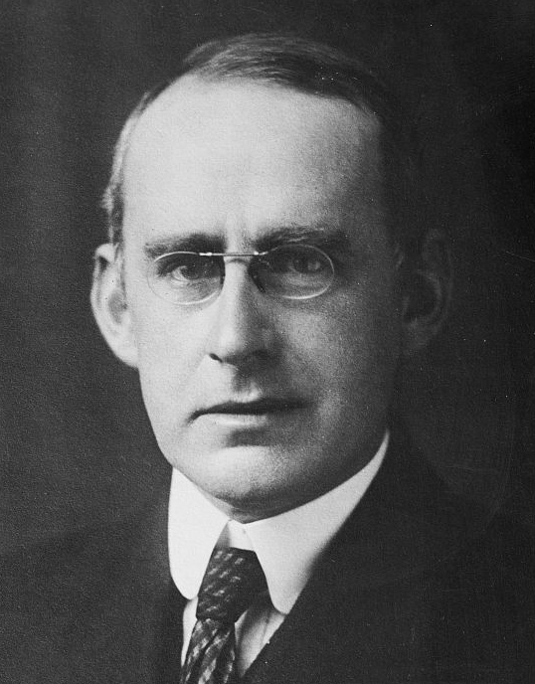
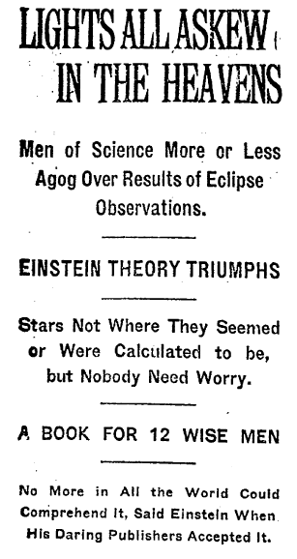
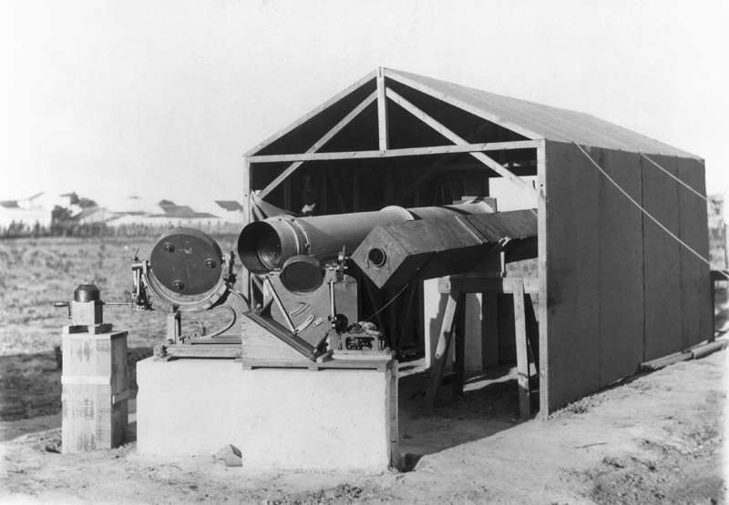
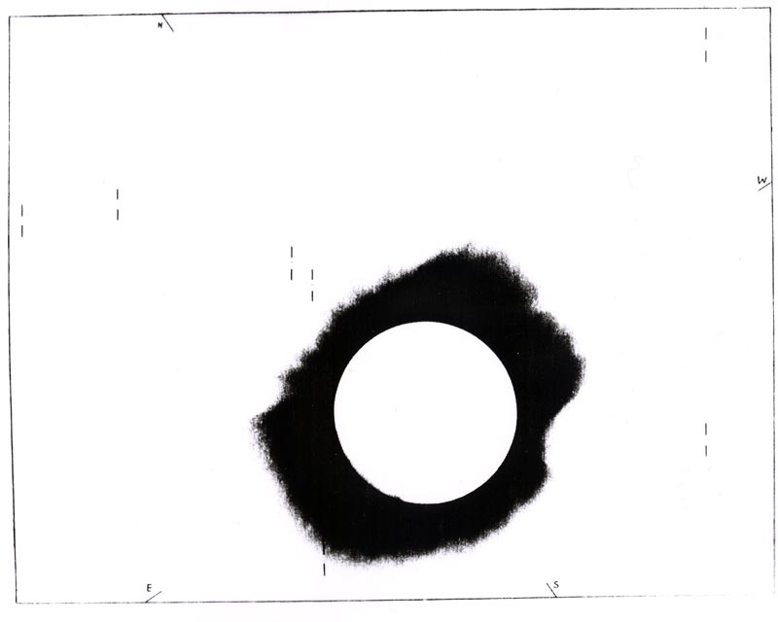
Geometry bends light: The 1919 Eclipse
A. S. Eddington
Sobral site
Photo from Principe

Slide 7
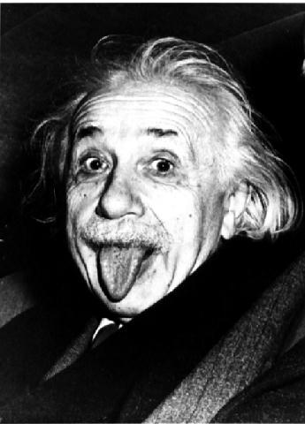
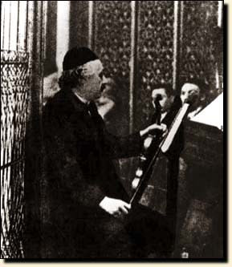
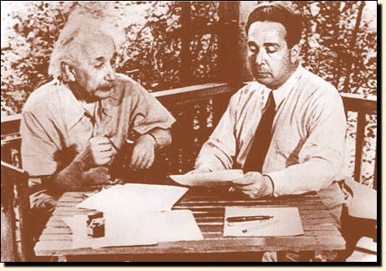
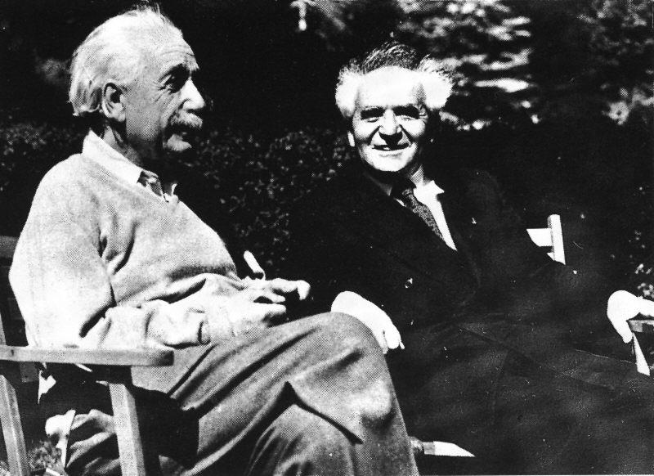
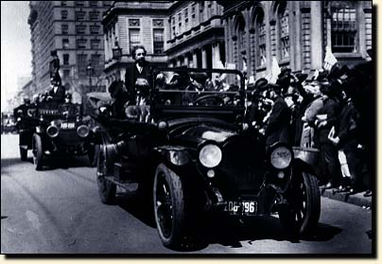
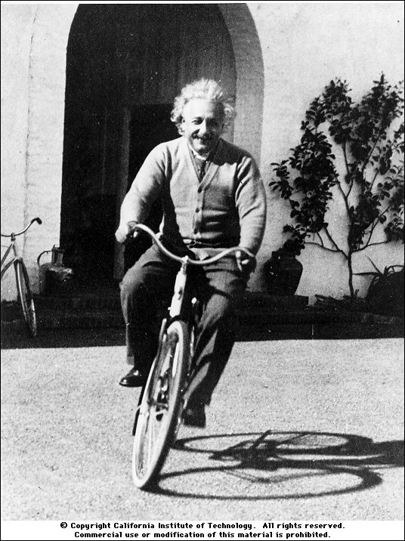

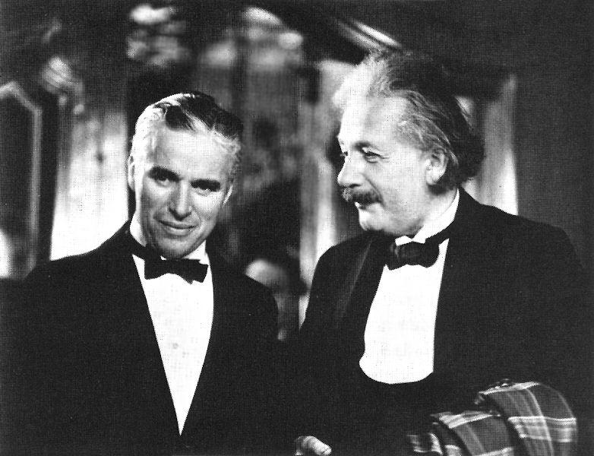
The public
Einstein

Slide 8
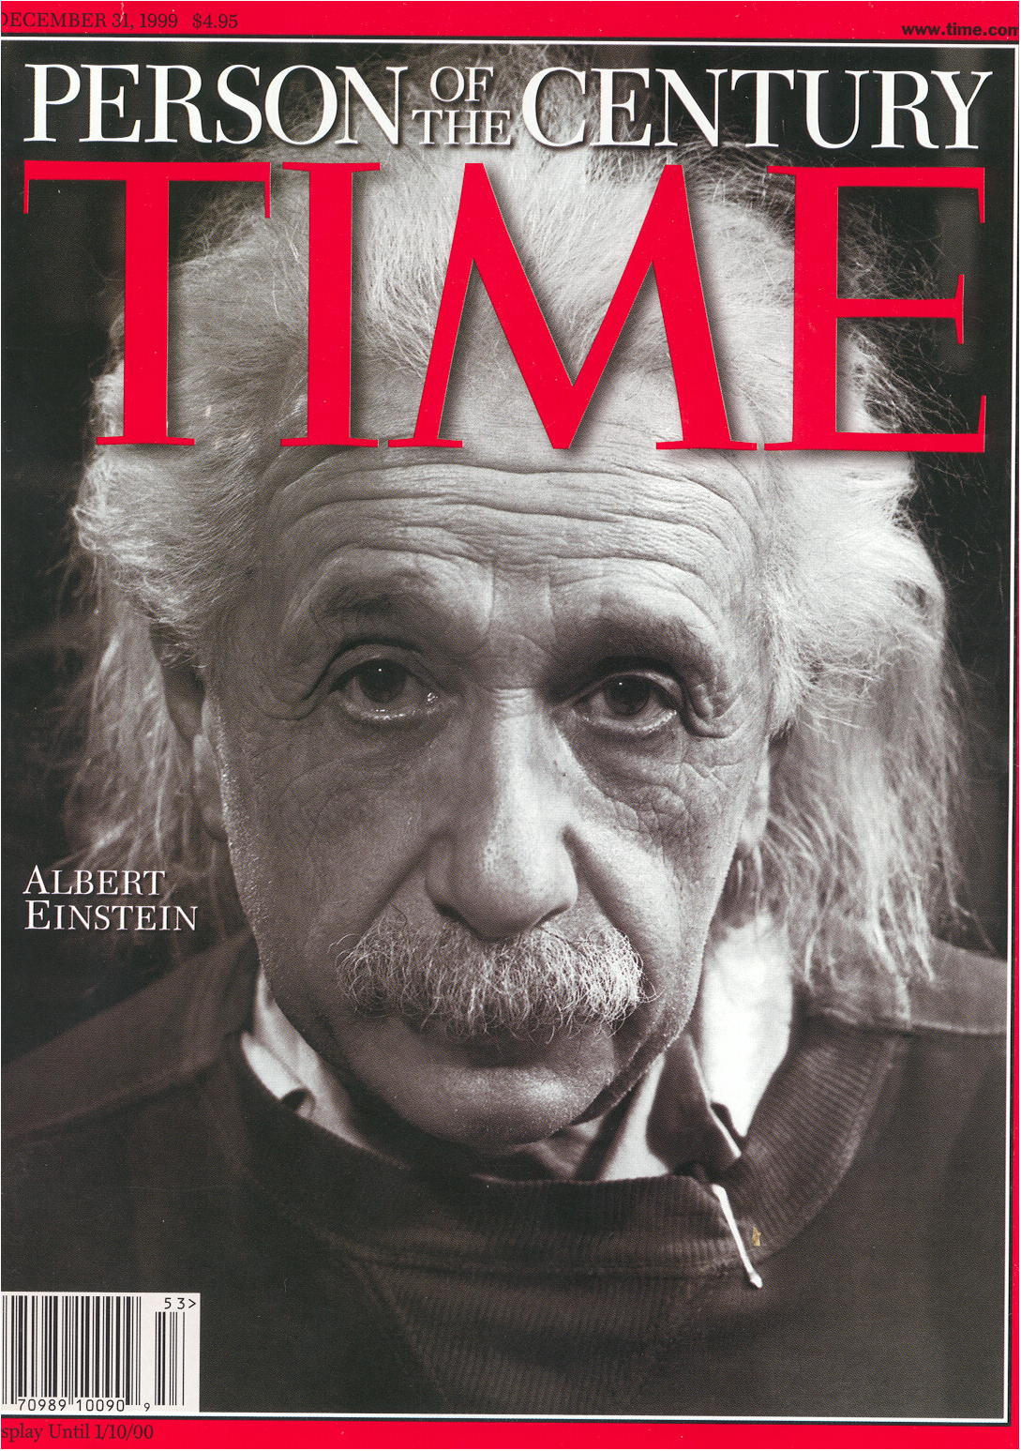
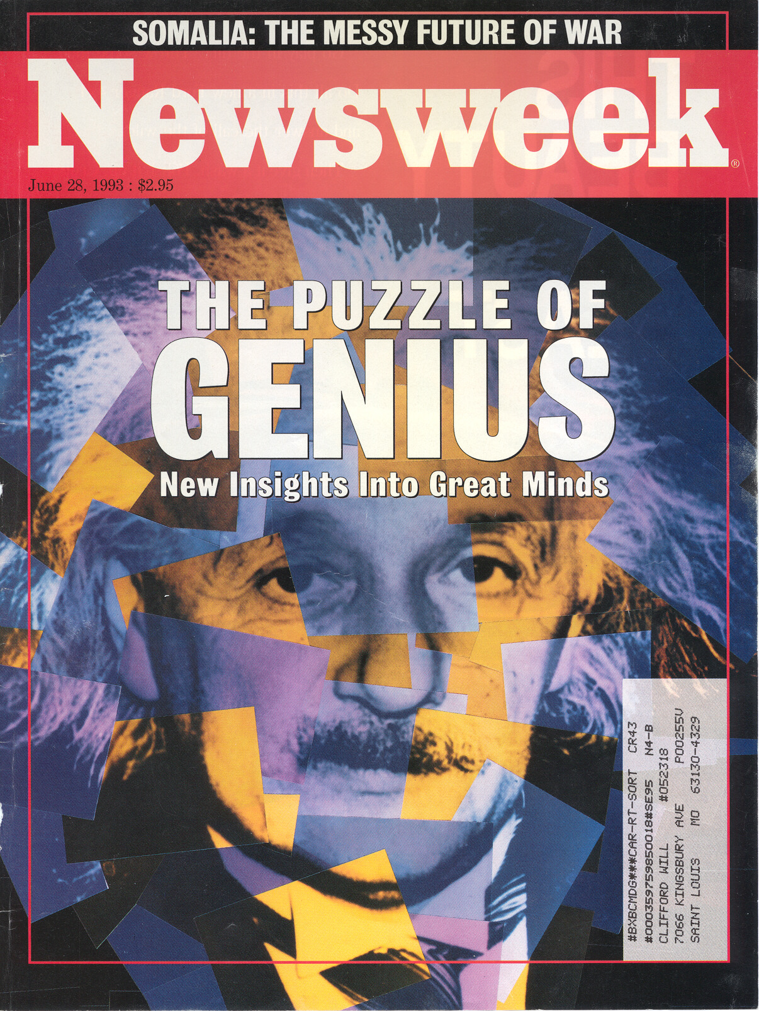

Slide 9
Geometry bends light: The PPN parameter γ

Slide 10






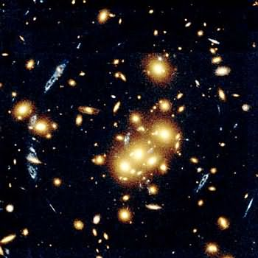

Geometry bends light: Gravitational lenses
Einstein’s gift
to astronomy

Slide 11
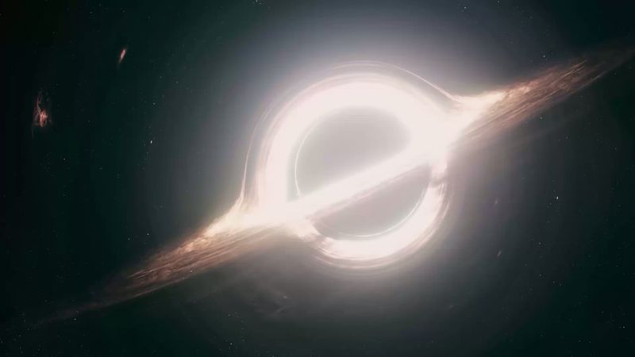
Geometry bends light ....& wins an Oscar!
Interstellar, Paramount Pictures
Directed by Christopher Nolan
Image based on calculations by Kip Thorne and Double Negative Co.

Slide 12
Was Einstein Right?
A Centennial Assessment
Early struggles
Highlights from the first century
Prospects for the second century
Gravity is geometry
Geometry bends light
Geometry warps time
Geometry moves mass
Geometry makes waves
Seven Pines Symposium XIX, 13-17 May 2015

Slide 13
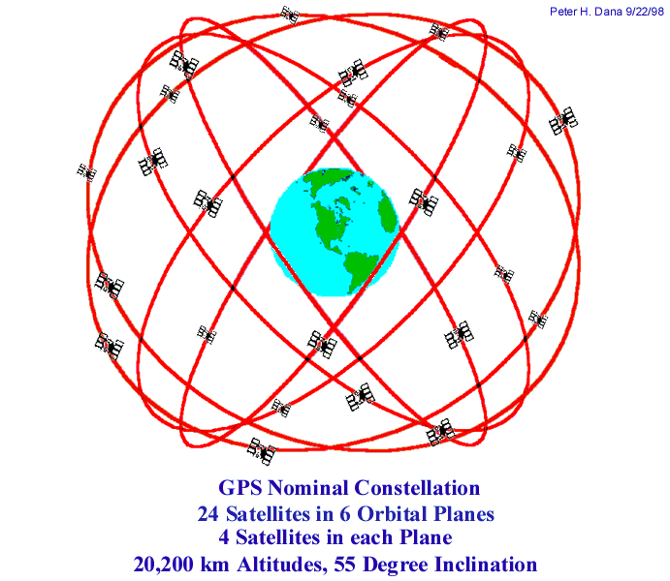
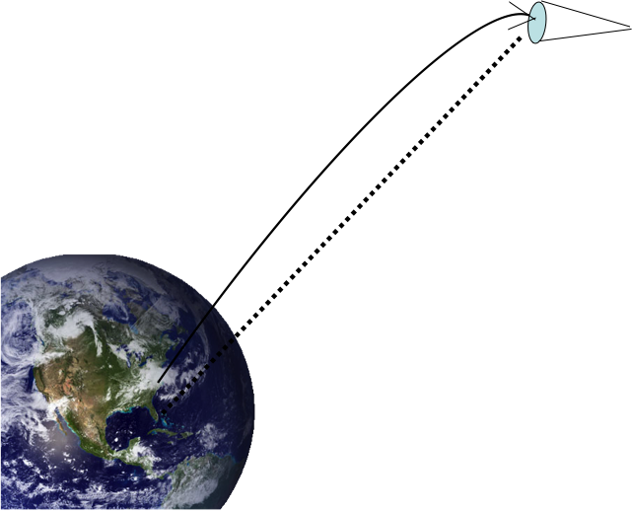
Geometry warps time: The redshift
1907: Einstein’s “happiest thought”
1917: C. E. St. John and others: no Solar redshift effect
1960: Pound-Rebka: gamma rays from ⁵⁷Fe over 23 m
1962, 1972, 1991: finally, the Solar redshift measured
1976: Gravity Probe A
1980s – now: GPS
2010: ²⁷Aluminum ion clocks
over 1/3 m
2016: ACES/PHARAO on the ISS
Gravity Probe A

Slide 14
Was Einstein Right?
A Centennial Assessment
Early struggles
Highlights from the first century
Prospects for the second century
Gravity is geometry
Geometry bends light
Geometry warps time
Geometry moves mass
Geometry makes waves
Seven Pines Symposium XIX, 13-17 May 2015

Slide 15
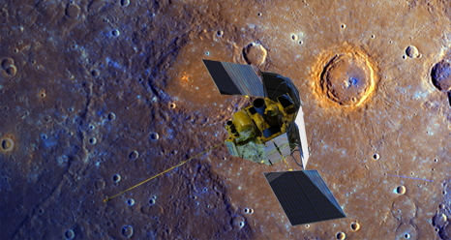
Geometry moves mass: Mercury’s perihelion
1687 Newtonian triumph
1859 Leverrier’s conundrum
1900 A turn-of-the century crisis
1915 “Palpitations of the heart”
575 “
per
century
J₂=2.2x10⁻⁷

Slide 16
Geometry moves mass: GR test-beds
The Double
Pulsar
Courtesy M. Kramer

Slide 17
Was Einstein Right?
A Centennial Assessment
Early struggles
Highlights from the first century
Prospects for the second century
Gravity is geometry
Geometry bends light
Geometry warps time
Geometry moves mass
Geometry makes waves
Seven Pines Symposium XIX, 13-17 May 2015

Slide 18
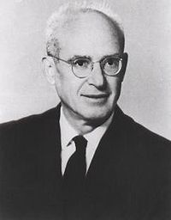

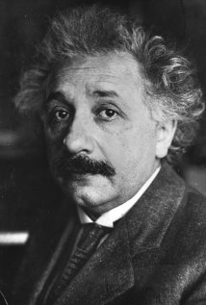
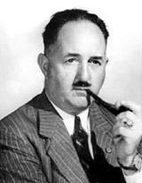
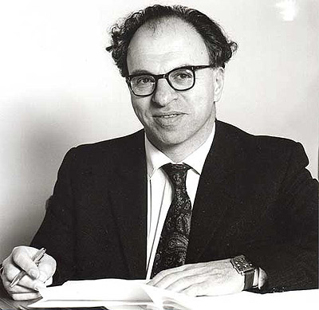
Are gravitational waves real?
Einstein 1916
Eddington 1922
Einstein & Rosen 1938
?
H. P. Robertson
Hermann Bondi 1950s

Slide 19
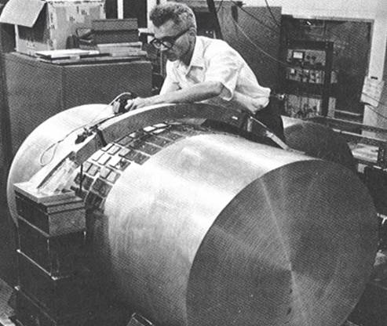
Joseph Weber & Gravitational Waves
Joseph Weber 1970

Slide 20

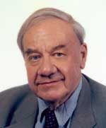
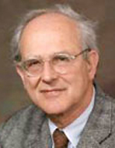
Joseph Weber & Gravitational Waves:
Case History in How Science Works
Joe Weber (1919-2000)
pioneer in electronics, masers and lasers
1959 - learned GR, began building GW detectors
1969 - reported coincident events in detectors 1000 km apart
1971 - more events when bars were perpendicular to galactic center
strength of signals 1000 times stronger than anybody expected
1970s - spurred theoretical work on black holes, neutron stars, supernovas
  could not explain Weber’s events
1970s - spurred other groups to build detectors of better sensitivity
  no events detected
1980 - consensus developed - no GW seen directly by Weber
1980 - 2004 - work on advanced “Weber bars” continued
Laser interferometry
Bob Forward
Ron Drever
Rai Weiss

Slide 21
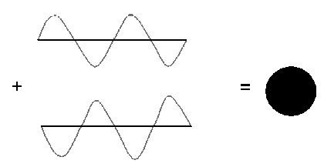
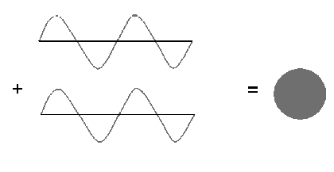
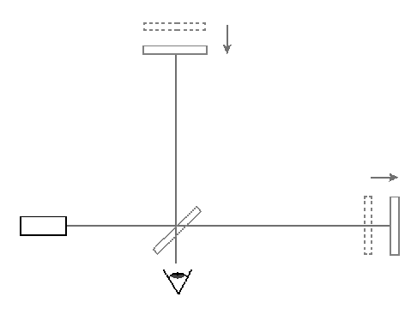
Laser Interferometry

Slide 22
Joseph Weber & Gravitational Waves:
Case History in How Science Works
Joe Weber (1919-2000)
pioneer in electronics, masers and lasers
1959 - learned GR, began building GW detectors
1969 - reported coincident events in detectors 1000 km apart
1971 - more events when bars were perpendicular to galactic center
strength of signals 1000 times stronger than anybody expected
1970s - spurred theoretical work on black holes, neutron stars, supernovas
  could not explain Weber’s events
1970s - spurred other groups to build detectors of better sensitivity
  no events detected
1980 - consensus developed - no GW seen directly by Weber
1980 - 2004 - work on advanced “Weber bars” continued
mid 1980s - plans developed for large “laser interferometer” observatories
1994 - 1999 - construction of LIGO
2002 - LIGO’s first science run
2003 - 2008 - Weber bar detectors phased out
2015 advLIGO- 2016 advVIRGO due to be back on the air

Slide 23
The problem of motion & radiation
Geodesic motion
1916 - Einstein - gravitational radiation (wrong by factor 2)
1916 - Droste & De Sitter - n-body equations of motion
1937-38 - center-of-mass acceleration (Levi-Civita/Eddington-Clark)
1938 - EIH paper
1960s - Fock & Chandrasekhar - PN approximation
1974 - numerical relativity - BH head-on collision
1974 - discovery of PSR 1913+16
1976 - Ehlers et al - critique of foundations of EOM
1976 - PN corrections to gravitational waves (EWW)
1979 - measurement of damping of binary pulsar orbit

Slide 24
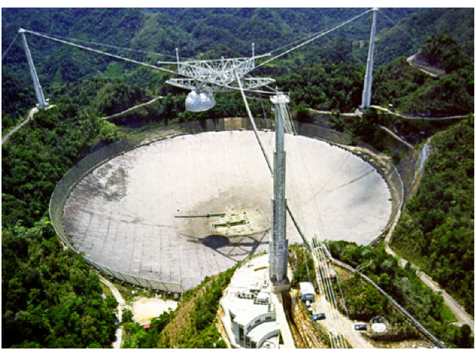
Binary Pulsars: Gravitational Waves Exist!
Discovery: 1974
Pulse period: 59 ms (16cps)
Orbit period: 8 hours
P_{p} = 0.059029997929883 + 7 sec
P_{o} = 27906.9807804 + 6 sec
Binary systems emit gravitational waves
Gravitational waves carry energy
System loses energy, spirals inward
Orbit period decreases at a predicted rate
0.0000758 seconds/year
Observed rate
0.0000759 + 2 seconds/year
1993 Nobel
Prize to
Joe Taylor &
Russell Hulse

Slide 25
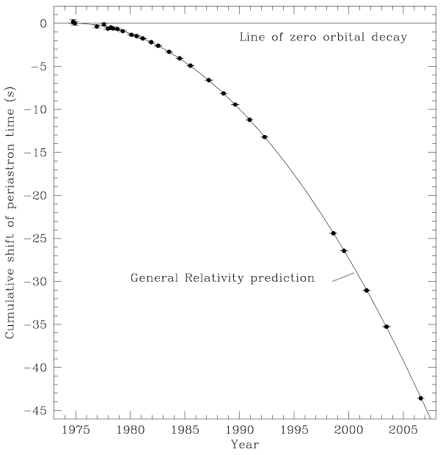
Decay of the orbit of PSR 1913+16
From Weisberg
Nice & Taylor (2010)

Slide 26
The problem of motion & radiation
Geodesic motion
1916 - Einstein - gravitational radiation (wrong by factor 2)
1916 - Droste & De Sitter - n-body equations of motion
1937-38 - center-of-mass acceleration (Levi-Civita/Eddington-Clark)
1938 - EIH paper
1960s - Fock & Chandrasekhar - PN approximation
1974 - numerical relativity - BH head-on collision
1974 - discovery of PSR 1913+16
1976 - Ehlers et al - critique of foundations of EOM
1976 - PN corrections to gravitational waves (EWW)
1979 - measurement of damping of binary pulsar orbit
1990s to now - EOM and gravitational waves to HIGH PN order
  driven by requirements for GW detectors
2005 – binary black hole breakthrough

Slide 27
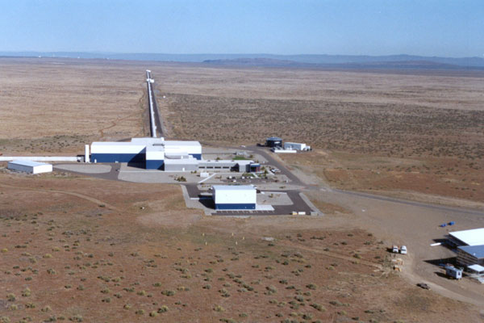
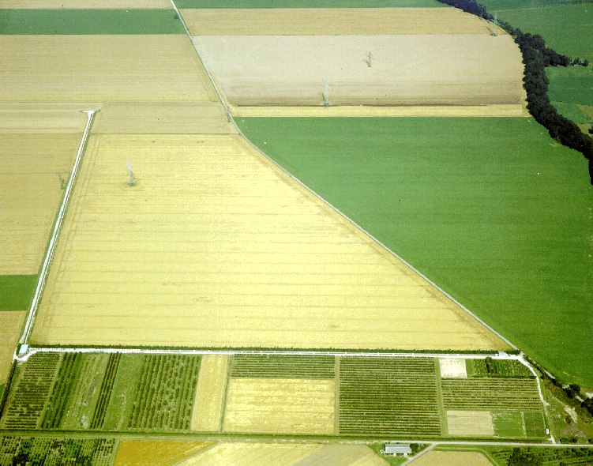
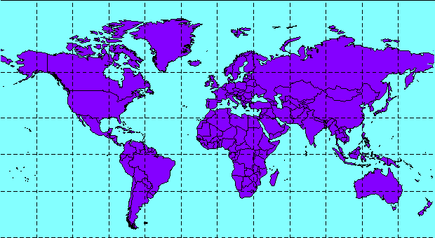
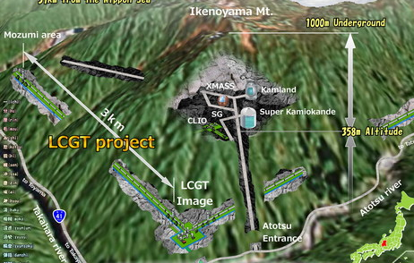
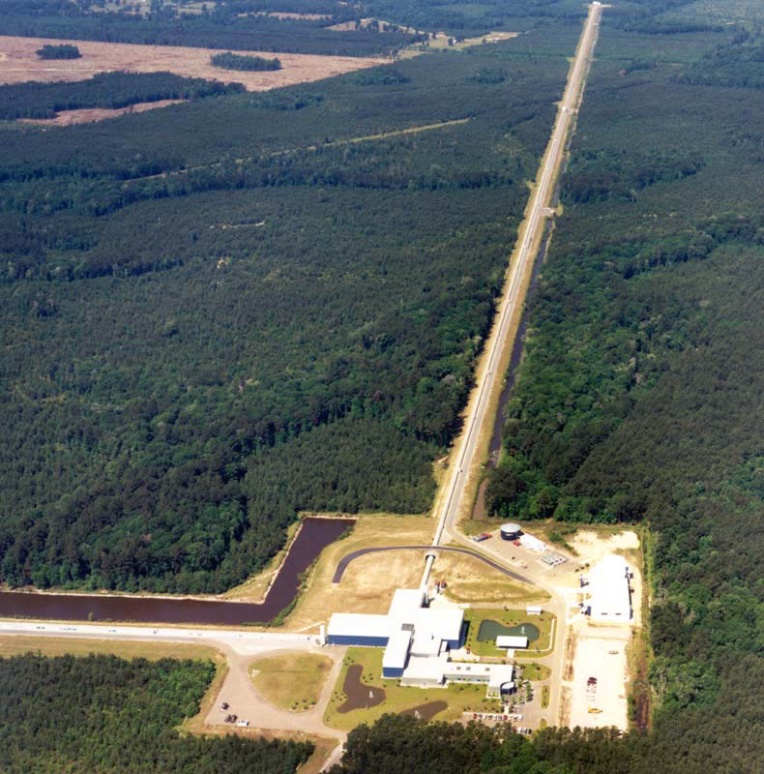
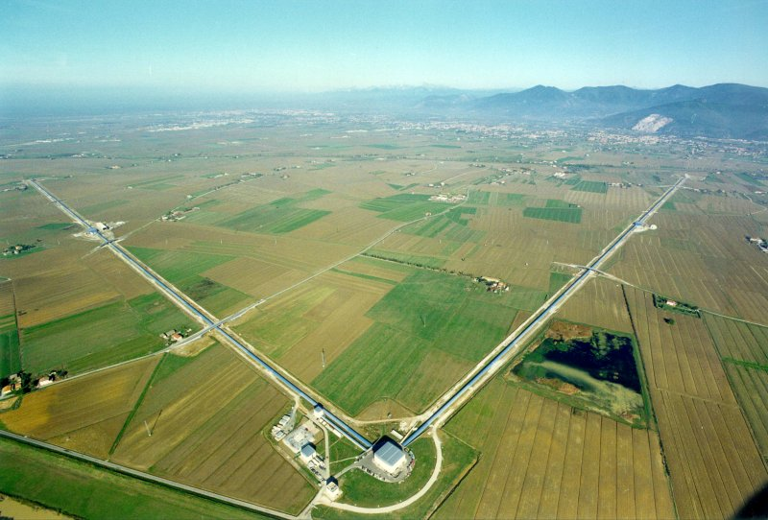
A Global Network of Interferometers
LIGO Hanford 4 km (2015)
GEO Hannover 600 m
Kagra Japan
3 km (2018)
LIGO India
(2022)
Virgo 3 km (2016)
LIGO Livingston 4 km (2015)

Slide 28
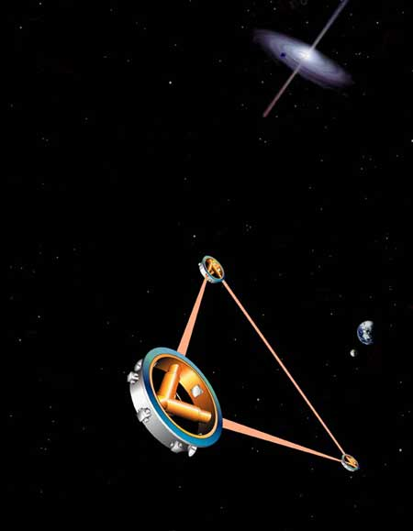
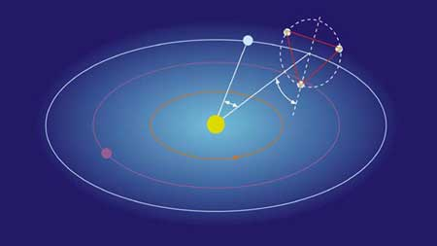
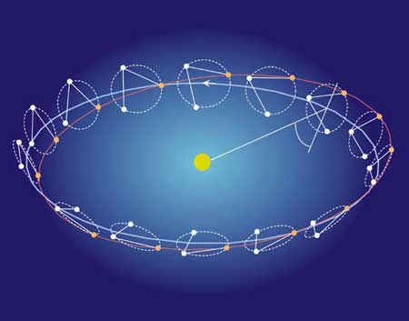
eLISA: a European space interferometer (2034)
with NASA participation

Slide 29
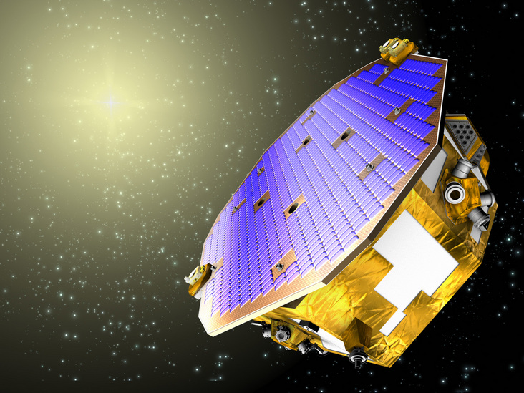
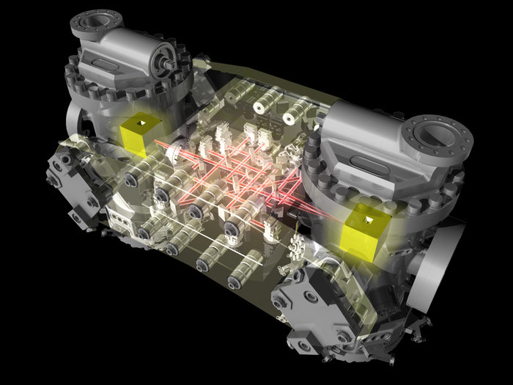
LISA Pathfinder – a critical milestone
A test of key eLISA technologies:
Proof mass metrology
Drag free control
Launch: September 2015 for a 6-month mission

Slide 30
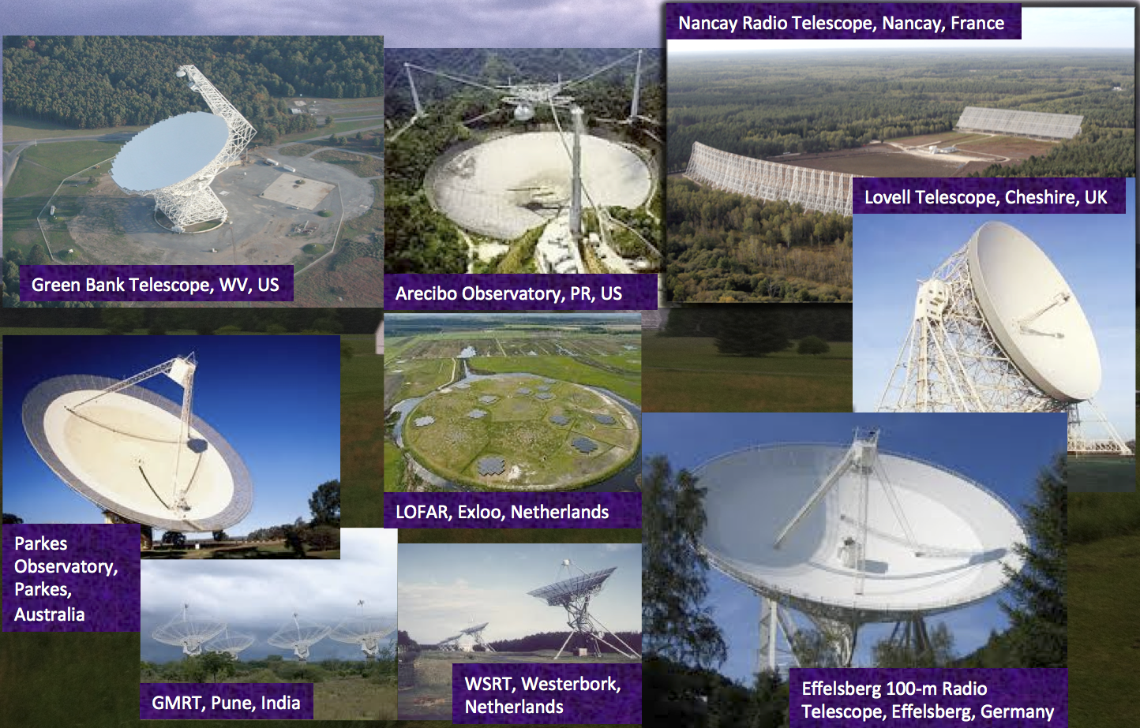
Pulsar Timing Arrays

Slide 31
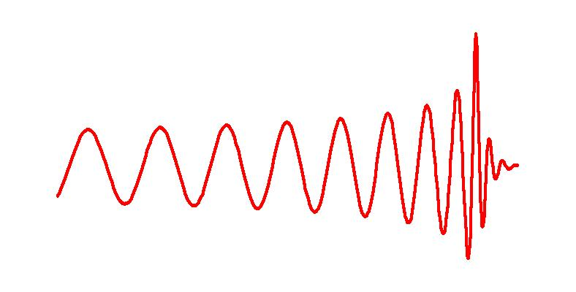
Inspiralling Compact Binaries:
Strong Gravity GR Tests?
Ringdown
Ground-Based (hectahertz)
  Last few minutes (10K
  cycles) for NS-NS
  0.4 - 400 per year by 2018
  BH-BH could be 0.4 - 1000
Space-Based (millihertz)
  MBH pairs (10⁵ - 10⁷ M_{s}) in
  galaxies to large Z
  EMRIs
  Close WD binaries
Pulsar Timing Arrays (nanohertz)
  MBH pairs
Merger waveform
A chirp waveform
Last 4 orbits

Slide 32
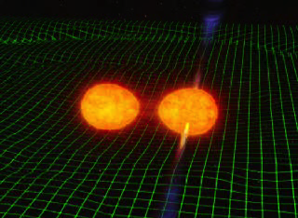

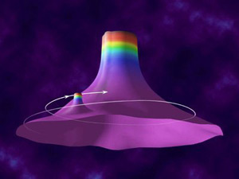
Listening to the universe in gravity waves
A chirp (inspiral)
A tone (pulsar)
A thud (supernova)
A hiss (cosmic background)
Interference (detector noise)
Notes:
Increase by a million-billion times

Slide 33
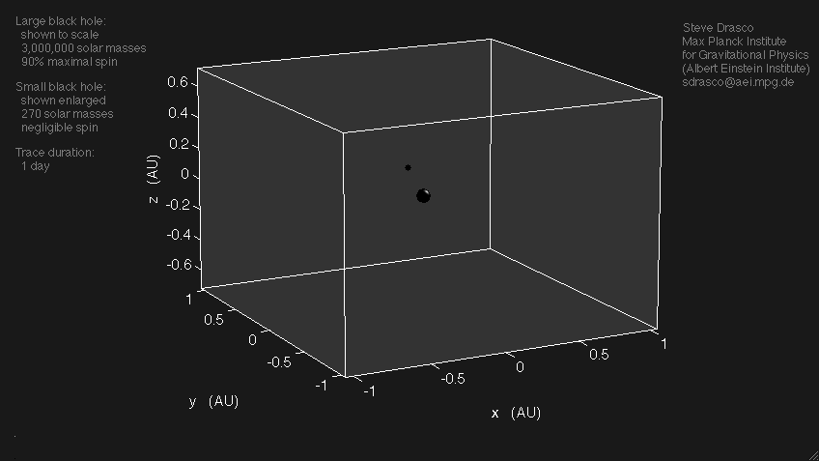
Listening to the GW from EMRIs
Animation by Steve Drasco

Slide 34
Gravitational-wave tests of GR: Polarizations
Array of ground based detectors
Modulation due to eLISA’s orbit
Correlation of pulsar timing residuals as a function of angular separation
CMW, Living Reviews in Relativity 17, 4 (2014)

Slide 35
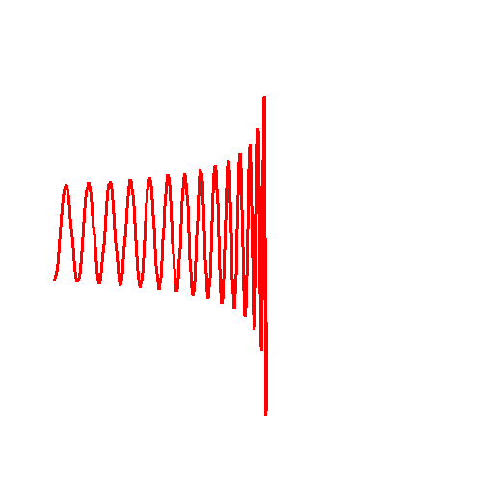
Gravitational-wave tests of GR: Speed
The first GR test following GW detection?
Gravitational-wave tests of GR:
Graviton mass
Source
Detector
adLIGO/VIRGO: 10¹² km
eLISA: 10¹⁶ km
CMW, PRD 57, 2061 (1998)

Slide 36
Was Einstein Right?
A Centennial Assessment
Einstein triumphant, or was he?
Early struggles and uncertainties
1st century themes
High precision technology (clocks, space)
Frameworks for comparing and testing theories
Theory-experiment synergy
2nd century themes
Strong-field tests
Gravitational-wave tests
Extreme-range tests

Slide 37
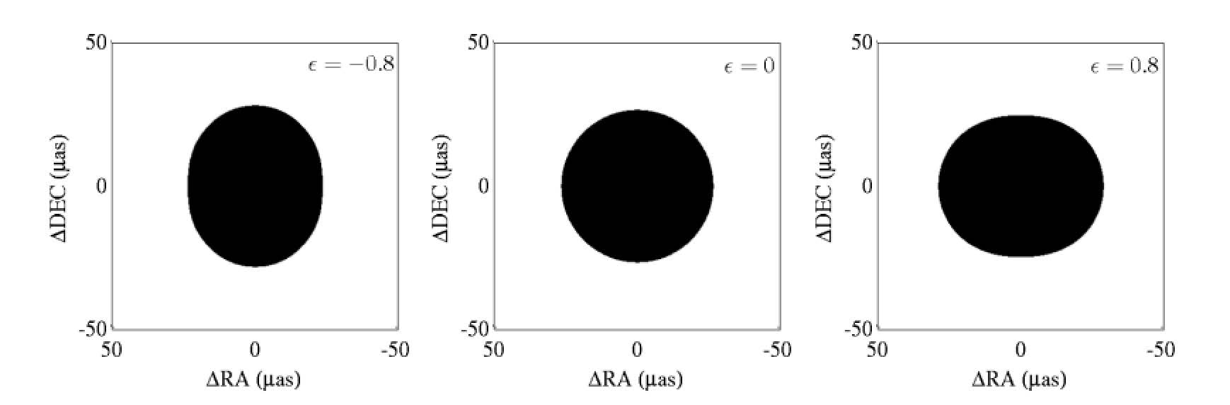
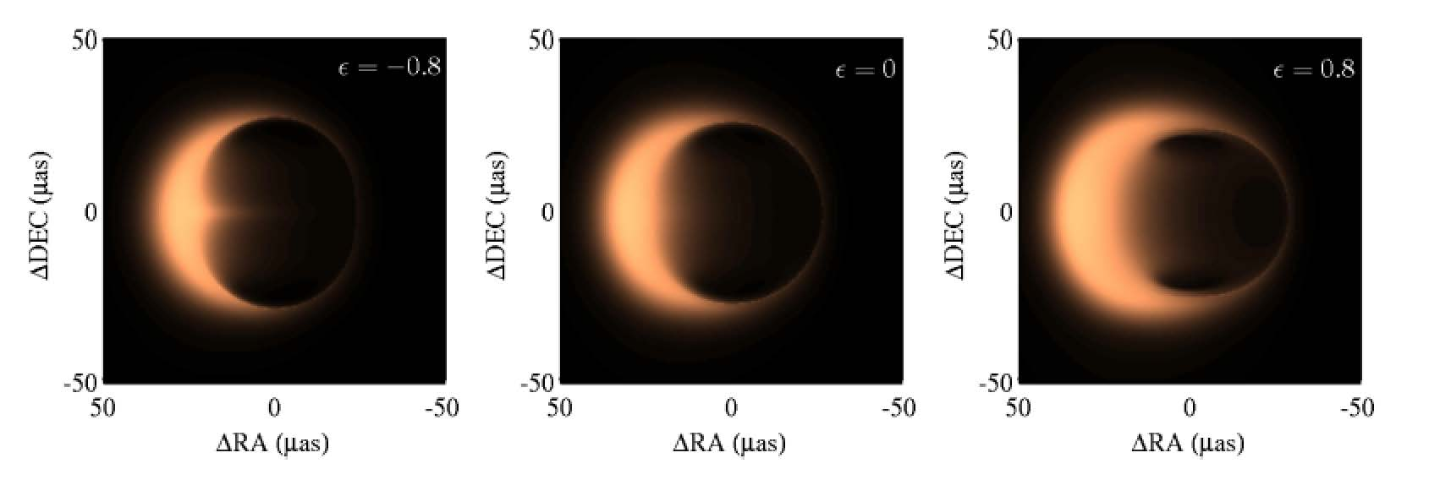
Strong-Field tests of general relativity
neutron star masses and radii
existence of event horizons with ADAFs
measurement of maximum BH spins
short gamma-ray bursts
tidal disruption events
testing the no-hair theorem
at the galactic center
direct imaging of nearby BH
(SgrA*, M87)
Extreme-range tests of general relativity
gravity at sub-mm and micron scales
dark matter vs. modified gravity at galactic scales
evolution of structure - dark energy vs. f(R)

Slide 38
Was Einstein Right?
A Centennial Assessment
Clifford Will
University of Florida, Gainesville
Institut d’Astrophysique de Paris
Seven Pines Symposium XIX, 13-17 May 2015

